Slide 1
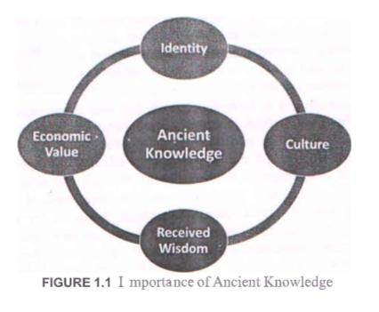
The Vedic Corpus Importance of Ancient knowledge definition

Slide 2
1. Historical Perspective: Understanding ancient knowledge provides a historical
perspective on the development of human civilization, offering insights into the
foundations of modern knowledge.
2. Cultural Understanding: It fosters a deep understanding of different cultures, traditions, and belief systems, helping students appreciate diverse perspectives and values.
3. Continuity and Change: By studying ancient knowledge, students can observe how ideas, beliefs, and practices have evolved or remained constant over time, contributing to a broader understanding of change and continuity.
4. Technological Evolution: Ancient knowledge often laid the groundwork for modern technologies. Learning about ancient inventions and discoveries can offer insight into their evolution over time.

Slide 3
Indian knowledge System Corpus
The term "IKS Corpus" could refer to a collection or body of texts, documents, or data specifically related to the Indian Knowledge System (IKS). This corpus might consist of various sources such as ancient texts, manuscripts, research papers, philosophical treatises, scientific writings, historical documents, or any materials relevant to the diverse knowledge systems present in India, spanning fields like philosophy, science, mathematics, medicine, art, and spirituality. This compilation or corpus serves as a resource for studying and understanding the principles, concepts, and wisdom encompassed within the Indian knowledge tradition.

Slide 4
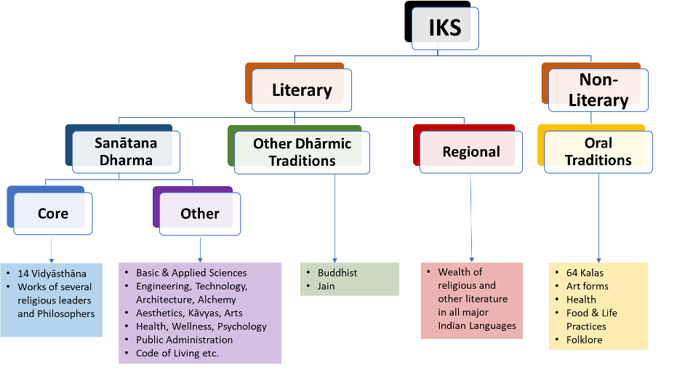

Slide 5
A. Literary: Among the literary sources, we can broad ly identify three categories. One of the major sources is the Vedic and allied literature, which we shall designate as Sanatana-dharma literature, presented mainly in the Sanskrit language. The second major source is the literature on other dharmic traditions. The third group is a large repository of knowledge in other Indian languages and dialectics.
B. Non-literary: The non-literary source is predominantly available through a rich set of oral traditions found throughout the country.
Sanatan Dhrama: Behavior in Sanatan Dharma, or Hinduism, is guided by several important principles and values that influence how individuals are expected to conduct themselves. Here are some key behavioral aspects in simple language:
Respect and Non-violence (Ahimsa): Sanatan Dharma emphasizes showing respect and
kindness to all living beings. It encourages non-violence, both in actions and in words.
Duty (Dharma): Every person has certain duties or responsibilities in life. Doing one's duty well and in a righteous manner is considered important.

Slide 6
Truthfulness (Satya): Being truthful and honest in thoughts, words, and actions is highly valued in Hinduism.
Respect for Elders and Teachers: Showing reverence and respect to elders, parents, teachers, and those with wisdom is considered a significant aspect of Hindu behavior.
Self-Control (Sanyam): Sanatan Dharma emphasizes controlling one's desires and impulses, practicing self-discipline, and avoiding excesses.
Compassion and Generosity: Displaying compassion, empathy, and generosity towards others is encouraged.
Devotion and Spiritual Practices: Engaging in religious rituals, prayers, meditation, and devotional practices is seen as an important aspect of behavior.
Cleanliness and Purity: Maintaining personal and environmental cleanliness is valued. Purity in thought, word, and action is also encouraged.
Serving Others (Seva): Helping and serving others, especially those in need, is considered a virtuous behavior.
Humility: Practicing humility and avoiding arrogance or pride is encouraged

Slide 7
Dharmik tradition :
Duty (Dharma): Doing one's duties or responsibilities with honesty and dedication is an important part of Dharmik tradition.
Respect for Elders: Showing respect, care, and reverence to elders and seeking their guidance is a significant aspect.
Daily Rituals and Practices: Engaging in daily rituals such as prayers, chanting, and acts of worship is a common practice.
Festivals and Celebrations: Celebrating various festivals with enthusiasm and joy, such as Diwali, Holi, and Navratri.Virtues and Morality: Upholding virtues such as truthfulness, kindness, patience, and fairness in all actions and behaviors.
Pilgrimages and Sacred Places: Visiting holy places and undertaking pilgrimages for spiritual growth and connection with the divine.
Reverence for Nature: Respecting nature and acknowledging its importance in life, often
through rituals that honor the environment.
Karma and Reincarnation: Understanding the concept of karma (actions and their
consequences) and the belief in reincarnation (the cycle of birth and rebirth).

Slide 8
Respect for Scriptures and Teachers: Revering sacred texts like the Vedas and giving respect to gurus (teachers) who impart knowledge and wisdom.
Service and Charity: Practicing Seva (selfless service) and offering charity to those in need as a way of giving back to society.

Slide 9
History of IKS
Ancient Roots: IKS dates back thousands of years, with its origins rooted in the Vedic period, around 1500 BCE, where ancient texts like the Vedas were composed.
Contributions in Science and Mathematics: Indian scholars made significant contributions, such as the invention of zero, the decimal system, algebra, and advanced knowledge in astronomy and medicine.
Philosophical Texts: The Upanishads and other philosophical texts emerged, exploring concepts of spirituality, the self, and the nature of reality.
Influence of Great Empires: IKS flourished during the rule of great empires like the Mauryas and Guptas, where art, science, and culture thrived.
Influence on the Silk Road: India's knowledge spread through trade routes like the Silk Road, where Indian scholars exchanged ideas with other cultures.
Islamic and Persian Influence: During the Islamic and Persian rule in India, there was an exchange of knowledge, influencing fields like architecture, astronomy, and mathematics.

Slide 10
Colonial Period: British colonization had an impact, leading to a decline in traditional knowledge systems due to cultural imposition and education policies favoring Western knowledge.
Revival and Independence: Post-independence, efforts were made to revive and preserve traditional knowledge systems, leading to the establishment of research institutes and educational reforms.
Global Recognition: In recent times, aspects of IKS, like yoga, Ayurveda, and philosophical thought, gained recognition and acceptance worldwide.
Continued Evolution and Preservation: IKS continues to evolve, adapting traditional knowledge to modern contexts while also preserving its ancient heritage.

Slide 11
Some Unique Aspects of IKS:
Certainly! India's knowledge system is rich and diverse, incorporating various unique aspects. Here are ten simple points highlighting some of its unique characteristics:
Ancient Texts and Scriptures: India's knowledge system is rooted in ancient texts like the Vedas, Upanishads, and other philosophical treatises that delve into diverse subjects, from philosophy to science and spirituality.
Yoga and Ayurveda: India has given the world invaluable gifts like yoga, a holistic system for physical and mental well-being, and Ayurveda, a traditional system of medicine focusing on natural healing and lifestyle balance.
Jugaad Innovation: The concept of 'jugaad' reflects a frugal and innovative approach to problem-solving. It involves finding quick and low-cost solutions using limited resources, showcasing Indian creativity

Slide 12
Gurukul Education System: Historically, the Gurukul system emphasized a direct, personal connection between teacher and student, fostering a more holistic and personalized form of education.
Unity in Diversity: Indian knowledge embraces diversity and pluralism. It respects various beliefs, cultures, and traditions, promoting harmony among different ideologies.
Artistic and Cultural Heritage: India's knowledge system is deeply interwoven with its artistic and cultural heritage, including classical dance, music, and various art forms, preserving andconveying knowledge through creative expression.
Concept of Dharma: Dharma, a fundamental concept in Indian thought, encompasses moral and ethical principles guiding individuals to lead a righteous and purposeful life.

Slide 13
Decimal System and Zero: India's mathematical contributions include the invention of the decimal numeral system and the concept of zero, which revolutionized mathematics and science globally.
Tolerance and Non-Violence: Indian wisdom advocates principles of non-violence (ahimsa) and tolerance, emphasizing peaceful coexistence and respect for all life forms.
Spiritual Wisdom: India's knowledge system places a significant emphasis on spiritual wisdom and inner exploration, advocating practices like meditation and introspection for personal growth and self-realization.

